Slide 1
Dual VET in Germany

Slide 2
Contents
Dual VET in Germany
Basics and Framework Conditions
Motivation, Interests and Process
The Success Model
Notes:
1. Examination boards with equal representation, jointly agreed training standards, joint management of the system at all levels
2. Around 70 % in the company
3. Vocational training standards, certificate issued by the chamber
4. In and from the companies, state teachers at the vocational schools
5. Data reports, vocational training report, training standards (BIBB)

Slide 3
Dual VET:
Basics and Framework Conditions

Slide 4
Basics
Dual VET in the German Education System at a Glance
Labour market
VET
Fulltime school based
Dual VET
University education
School education

Slide 5
Basics
Parties involved: Trainees
1.22 Mio. trainees p. a.
in 327 recognised professions
That implies:
5 % of all employees are trainees
Around 91 % pass their training successfully.
Notes:
Supplementary information:
> Overall, , approximately 53 % of the population have started a dual vocational training programme in their lifetime
> The employment rate is high: approximately 96 % of all graduates find a job (compared to 82% without a vocational qualification)
The positive effect:
> Youth unemployment in Germany is only around 5 %

Slide 6
Basics
Parties involved: Employers
Every year, around 19% of all companies employing staff subject to social insurance contribution engage in training (ca. 408,700 of 2.2 Mio.)
Around 489,000 new trainees p. a.
77 % of them will be directly taken over after the training
Notes:
Supplementary information:
> Trainees are on average 20.0 years old
> The average investment per trainee per year is 18,000 euros
> 70 % of this (approx. 13,600 euros) is amortised (productive contribution of the trainees)
This means:
> international competitive advantage for German SMEs
> future personnel trained according to own needs
> low investment on the labour market international competitive advantage for German SMEs
> geringe Investitionen auf dem Personalmarkt

Slide 7
Basics
Businesses, Social partners and the Government ensure the Framework Conditions of Dual VET
Chambers
Social partners (Unions and Employers‘ associations)
Government
Chambers and Social Partners: Define and check training contents in the companies
Government: Shapes the legal framework and provides the resources for school-based training
Notes:
Supplementary information:
> The three stakeholders ensure the framework conditions for vocational education and training through a differentiated distribution of roles
> Ownership lies with all three players; they all bear it at the same time and assume responsibility
> They guarantee the system's constant capacity for innovation
> They ensure quality standards

Slide 8
Basics
Stakeholders: Chambers - the Competent Bodies
Check and register training companies
Monitor and check in-company training
Train in-company training personnel
Organise examinations
Organise events and engage in consultancy
Notes:
The impetus for the development and updating of training standards comes from companies and chambers. They know best which skills are needed.
Other tasks:
> Supporting companies in their search for trainees, registering training contracts
> Mediation in the event of disagreements between trainees and companies
> The economy invests €7.7 billion in vocational training every year

Slide 9
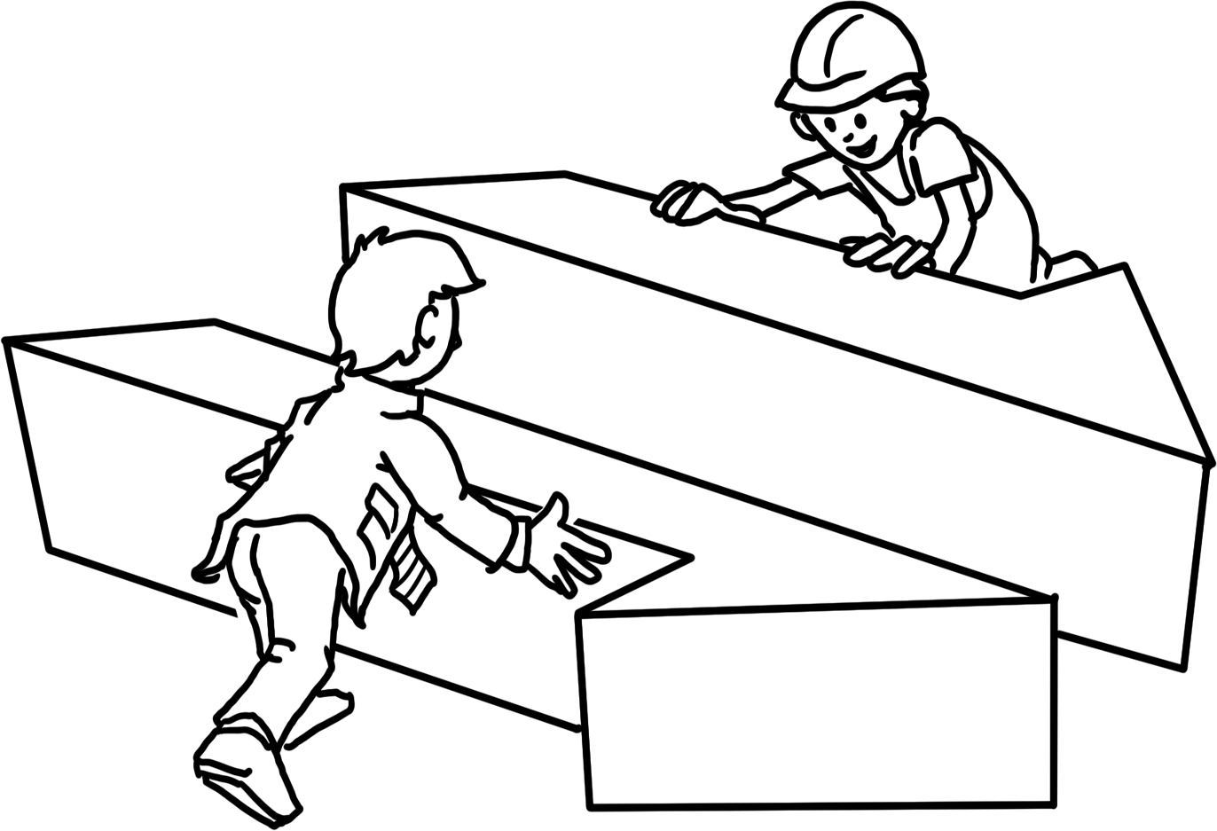
Basics
Stakeholders: Social Partners
Unions and Employers‘ associations negotiate the standards (training regulations) for in-company training with each other and with the Government
Training contents
Trainees‘ remuneration
Monitoring of in-company training
Participation in examination boards
Notes:
Supplementary information:
> The process of coordinating and adopting new training regulations is managed by the Federal Institute for Vocational Education and Training.
> Economic and social partners are involved in the entire process.

Slide 10
Basics
Stakeholders: The Government – Providing the Framework
Negotiates training regulations with the social partners (in-company training)
Defines training in vocational schools: framework curriculum
Finances and organises the public vocational school system
Conducts VET research (BIBB)
Supports people searching for an apprenticeship (e. g. teenagers, unemployed or disadvantaged people)
Notes:
Detailed information:
> State funding totals around € 6.8 billion, including over € 3 billion for 1,550 vocational schools and around € 2.4 billion for control, monitoring and support measures
> State passes the Vocational Training Act

Slide 11
Basics
The Framework: Standards
Define the implementation of dual VET in companies and vocational schools
Secure quality control and the promotion of dual VET
Are valid and compulsory nationwide
Notes:
> If necessary, summarise the previous slides again
> Three main stakeholders agree on the basic standards for dual vocational training on an equal footing.
> These standards are based on the specific requirements of the world of work.

Slide 12
Basics
The Framework: Standards – Development
1. Employers identify new tasks and qualifications in the companies
2. Social partners and the Government negotiate and pass new training standards, moderated by the BIBB
3. The Government adjusts framework curricula to the the newly-defined training standards
The adopted standards are fixed in training regulations (in-company training) and framework curricula (school-based training).
Notes:
Supplementary information:
> The duration of the further development and implementation of standards is max. 1 year
> Standards are dynamically adapted to the requirements of the world of work at both learning venues
> BIBB continuously researches changes in work and training; the findings are incorporated into the process

Slide 13
Basics
The Framework: Standards – Training Regulations
Training standards for in-company training are fixed in training regulations:
Occupational title
Training profile
Contents
Timeframe and temporal structure (training plan)
Examination requirements
Notes:
Job profile >>>
Which competences must be taught?
Contents >>>
Which specific skills and tasks must be mastered?

Slide 14
Basics
The Framework: Standards – Framework Curriculum
Training in the vocational school provides the necessary professional theoretical expertise and expands general knowledge.
These standards are defined in the framework curriculum:
Learning objective
Contents
Learning field
Notes:
The contents of the framework curriculum are defined by ‘learning fields’.
If necessary, explain the topic of ‘learning fields’ at this point.

Slide 15
Basics
The legal framework
Freedom of Occupation according to Article 12 of the Basic Law (Constitution)
Business Laws
School Laws
Vocational Training Act
Law for the protection of young people at work
Crafts and Trades Regulation Code
Law on Collectice Bargaining
Law on the Chambers of Commerce
Works Constitution Act
Compulsory schooling
Regional school laws
Notes:
Explain the dynamics of the vocational training system using BBiG amendments, most recently in 2020: principle of equivalence of vocational and academic education codified

Slide 16
Dual VET:
Motivation, Interests and Process

Slide 17
Access
Motivation and Measures – the Government
Motivation: Germany needs skilled workers to secure economic growth and development.
Insight: We need to strengthen and steer our dual VET system.
Measures:
Provide and update the legal framework
Mandate further stakeholders
Analyse and develop the system (e. g. through BIBB)
Notes:
Further motivation:
> Vocational training secures the social status of young people as citizens
> The state cannot guarantee vocational training alone: costs and competences
Further measures:
> Ensuring permeability: university access for trainees with a degree
> Opening up dual vocational training regardless of previous qualifications

Slide 18
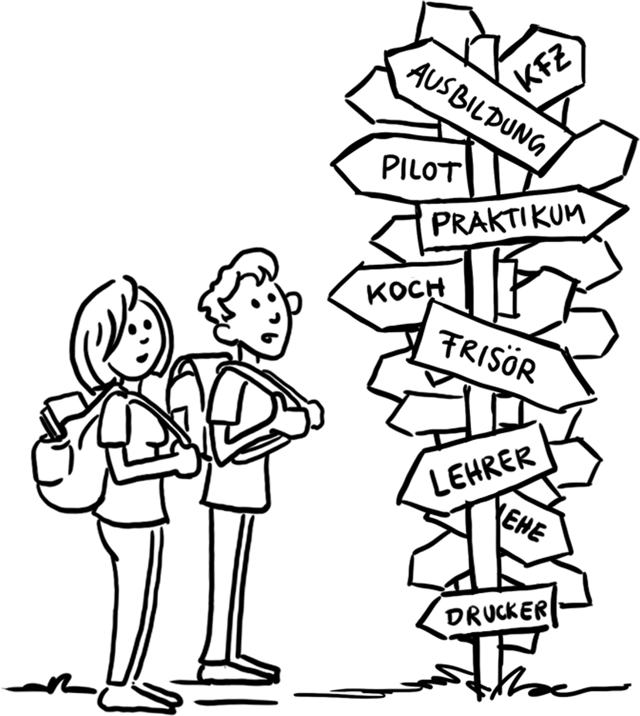
Access
Motivation and Access – Young People
Motivation: „I want to become a … !“
Access:
Find potential employers and screen openings
Write application
Undergo selection process
Choose training company
Sign training contract
Notes:
Young people have many different expectations and goals when it comes to an apprenticeship:
> learn something practical
> earn their own money (self-employment)
> realise a dream
> social prestige
> fulfilment of duties

Slide 19
Access
Motivation and Access – Companies
Motivation: „I need to be secure about filling all job openings.“
Access:
Register as a training company
Offer traineeships
Analyse applications
Choose trainees
Sign training contracts
Notes:
There are a few other reasons here too:
> We are looking for loyal employees
> We know best which qualifications are needed in our company
> We want to act in a socially responsible manner
> We seek the input and innovative potential of young people
> We save on familiarisation and retraining costs

Slide 20
Process
The Training Contract
The professional training starts with signing the training contract between employer and trainee.
The training contract regulates:
Duration
Contents
Probation period
Temporal and factual structure
Remuneration
Rights and obligations of both parties
Notes:
The training contract also regulates
> holiday entitlement
> any requirements for termination of the training contract
The training contract is similar to an employment contract. It is the basis for learning in the company during training.
The training contract is registered by the chambers.

Slide 21
Process
Dual Learning at two venues
70 % Training in the company
30 % Lessons in vocational school
Structured training under real work conditions
Trainees participate in actual business activities
Trainees receive a remuneration
Lessons in class
Occupation related (2/3) and
General (1/3) subjects
Dual VET lasts from two to three and a half years.
Notes:
Legal basis:
... for in-company training > Training contract
... for the vocational school > Compulsory schooling
Time allocation:
for example:
Monday to Wednesday: in the company
Thursday and Friday: at the vocational school
Alternatively: block teaching
Additional information:
> In-company training and vocational school lessons follow the training standards

Slide 22
Process
Examination
The Final Exam
Organised by the chamber
Theoretical and practical part
Examination board with
Employers‘ representatives
Employees‘ representatives (Trade Unions)
Vocational school teachers (representing the Government)
Notes:
Important:
No involvement of the respective teaching and training staff!

Slide 23
Process
The Final Exam
Vocational Certificate
Issued by the chamber
Officially recognised
The successful examination ends the training. The professional career begins.

Slide 24
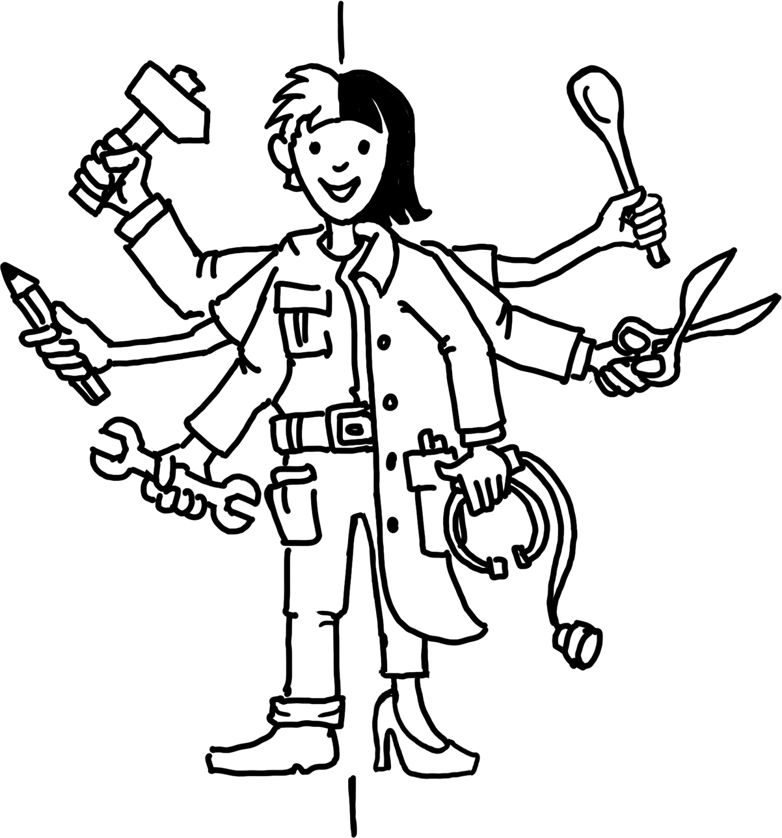
Process
Beginning of the Vocational Career: Opportunities
On the Labour Market
Employment contract with the initial training company
Employment contract with another company
Employment in another (neighbouring) vocational field
Continuation of Training
Further training measures (building on existing qualification, if applicable)
University studies („tertiary education“)
Notes:
As a reminder:
> Around 96% of all graduates in Germany find a job after completing their training.
> Around 74% of all trainees are taken on by the company that trained them.

Slide 25
Dual VET:
The Success Model

Slide 26
How Does Dual VET Work?
Summary
Process
Training parallel in the company (70 %) and vocational school (30 %): „Dual“
Training with defined contents and duration (Training contract)
Training in actual business operations
Final exam before an examination board

Slide 27
How Does Dual VET Work?
Summary
Framework
The Government provides the legal framework
The Government organises the school-based part of training
Chambers and social partners define contents and range of training
Chambers as competent bodies monitor company-based training
Notes:
Reminder:
Chambers are the representatives of the economy, trade unions/employee representatives and associations/employer representatives are the social partners.
They reach a consensus.
Conclusion I:
> Dual vocational training is essentially shaped by those who are directly affected and who know the needs of the labour market best.
Conclusion II:
> All decisions on vocational training are made by consensus.
Conclusion III:
> The standards apply nationwide. They are regularly updated.

Slide 28
Why is Dual VET in Germany Successful?
Success factors
Historically grown system
High acceptance in society
Win-win-situation for trainees and companies
Training according to the demand for skilled labour
Strong institutions (chambers, social partners, SME)
Active contributions by all stakeholders
High flexibility and adaptability of the system
Notes:
Demand for skilled labour:
> Germany is a developed industrialised nation with a strong SME sector.
Win-win situation:
> Apprentices learn on the job and are integrated into the work process. Companies train their own future workforce according to their own needs
Qualified training staff:
> Trainers are ‘from the trade’ and have undergone training themselves and also know the company
Supplementary information:
> Although the state controls the process as a legislator and sets the framework, it leaves key decisions to the direct stakeholders.

Slide 29
Five Quality Features of Dual VET
Cornerstones
Cooperation of government, business community and social partners
Learning within the work process
Acceptance of national standards
Qualified VET staff
Institutionalised research and advice
Notes:
Examination boards with equal representation, jointly agreed training standards, joint management of the system at all levels
2. Around 70 % in the company
3. Vocational training standards, certificate issued by the chamber
4. In and from the companies, state teachers at the vocational schools
5. Data reports, vocational training report, training standards (BIBB)

Slide 30
Benefits
Benefits for trainees:
Dual VET is the ideal preparation for a professional career:
Occupation specific competencies and qualification
Real work conditions (equipment, procedures, work environment)
Remuneration
Notes:
Further advantages:
> Greater identification with the training company
> Training as a basis for further measures

Slide 31
Benefits
Benefits for companies:
Dual VET secures qualified personnel:
Qualified workers, in accordance with company-specific requirements (as opposed to external applicants)
Increased productivity (fast amortisation)
Active participation of the business community in developing training standards
Contribution to Corporate Social Responsibility (CSR)
Notes:
Another advantage:
> Recruitment and retraining costs are reduced

Slide 32
Benefits
Benefits for the Government and Society:
Joint benefit, wealth and social peace:
High economic performance and productivity
Balance in the labour market (supply/demand)
Social and economic integration of young people
Contributions of all stakeholders
Notes:
Another advantage:
> Early indicator for developments in the economy and labour market

Slide 33
Challenges
Challenges from Trainees‘ Point of View
Discrepancy between demanded and supplied training positions (lack of openings)
Access to Dual VET
Increasing occupational demands
Lifelong learning
Notes:
Discrepancy:
> 2018: almost 80,000 applicants without a training place
Access:
> Lack of informal skills: Discipline, reliability, basic skills (reading, writing, maths)
Requirements:
> For example: IT skills, foreign language skills
Lifelong learning:
> Especially for older applicants

Slide 34
Challenges
Challenges from Businesses‘ Point of View
Discrepancy between demanded and supplied training positions (lack of applicants)
Unprepared trainees
Inclusion of people with special needs
Inclusion of migrants
Notes:
Discrepancy:
Unfilled training places 2010: 19,800 / 2018: 57,700 - almost tripled
‘Maturity for training’:
Lack of social skills, basic knowledge
Inclusion:
High extra personnel and time expenditure, special qualifications of the training staff

Slide 35
Challenges
Challenges from the Point of View of the Government and Society
Demografic change
Foreseeable lack of skilled labour
Trend of academisation
Regional discrepancies
Inclusion
Notes:
Demographic change
Fewer young people able to go into training, labour market needs can no longer be met
Trend towards academisation
Training tends to be out, university is in
Regional differences:
Supply and demand for training places
Inclusion:
as a social task

Slide 36
Further Sources
Facts and figures
BIBB Data Report (link)
Federal Statistical Office (link)
BMBF Data Portal (link)
BMBF TVET Report (link)
Dual VET standards
BIBB Brochure: Vocational Training Regulations and the Process Behind Them (link)
Example: training regulation and framework curriculum (link)
Legal documents
Vocational Training Act (link)
Works Constitution Act (link)
Web resources
GOVET
BMBF
BIBB
Contact for further questions
govet@govet.international

Slide 37
GOVET at BIBB

